Slide 1
Team Project
Andy Lopez, Samridhya Mukherjee, Manan Savaliya

Slide 2
Problem
Your team is involved in designing a new cryptocurrency for a sovereign client. You have been asked to evaluate Ethereum as a contender of bitcoin for the basis of your currency. What does your team think and would suggest as your team’s choice to your client?

Slide 3
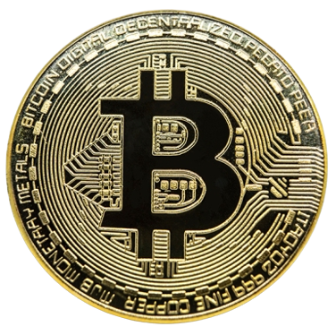
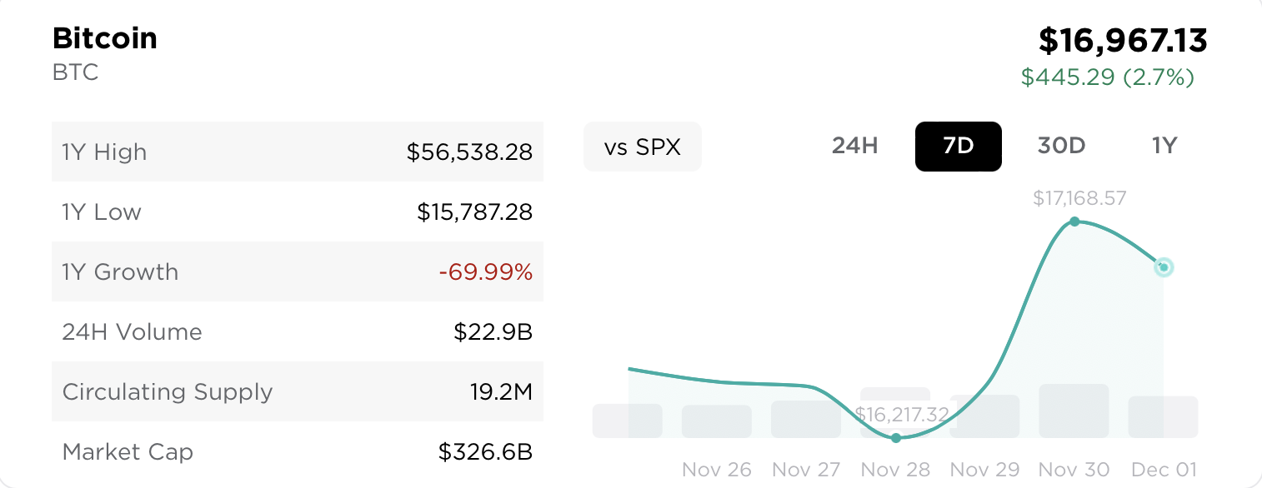
What is Bitcoin (BTC)?
Digital currency
To eliminate the need for banks, or governments
Stored in a digital wallet
You can either own a Bitcoin or own partial shares of one
Blockchain - prevent tampering
Private and Public Keys - securing ownership
Bitcoin mining - verifying transactions

Slide 4

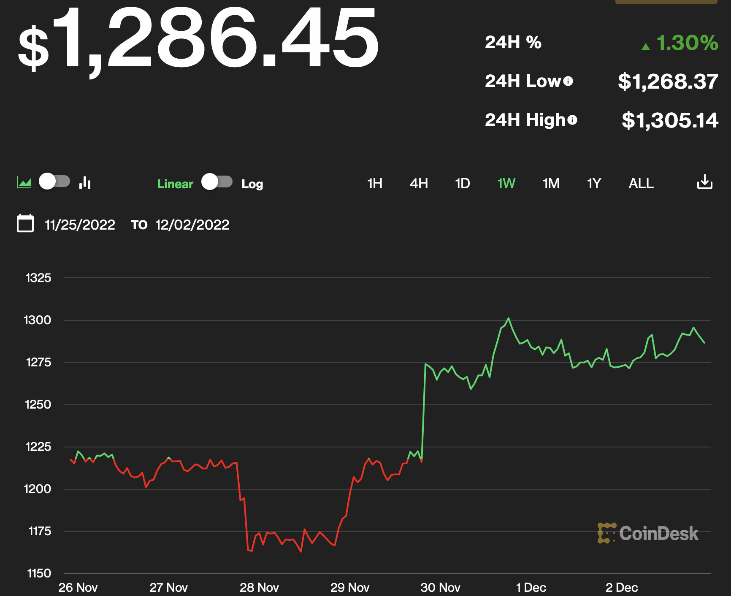
What is Ethereum (ETH)?
Another digital currency
Scalable, programmable, and secure
Blockchain based
Proof-of-Stake mechanism - uses Casper FFG and the algorithm LMD Ghost; combined to called Gasper
Rewards validators and punishes dishonesty
Also is a decentralized platform

Slide 5
Differences between the two
Bitcoin
Used strictly for payment
Uses proof-of-work, requiring miners to compete
Proof-of-work is highly energy intensive
Stores value
Blocks are added every 10 mins
Ethereum
Programmable, thus can be used for other applications
Uses proof-of-stake
NFTs are created using Ethereum
Interacts with application based on ETH blockchain
Blocks are added every 10 seconds

Slide 6
How the market has reacted to Bitcoin and Ethereum
Increased crypto-stocks correlation raises the possibility of spillovers of investor sentiment between those asset classes.
The increased crypto-stocks correlation between crypto and equity markets indicate a growing interconnectedness between the two asset classes that permits the transmission of shocks that can destabilize financial markets.
Given their relatively high volatility and valuations, their increased co-movement could soon pose risks to financial stability especially in countries with widespread crypto adoption.
FTX was previously one of the largest and fastest-growing crypto exchanges in the world after their bankruptcy the cryptocurrency is on very bad position. As cryptocurrency value has drastically gone down.
And Aside from current crash, experts say the source of crypto’s volatility up until now has been surging inflation, shifting U.S. monetary policy, mainstream adoption and the continuing war in Ukraine.

Slide 7
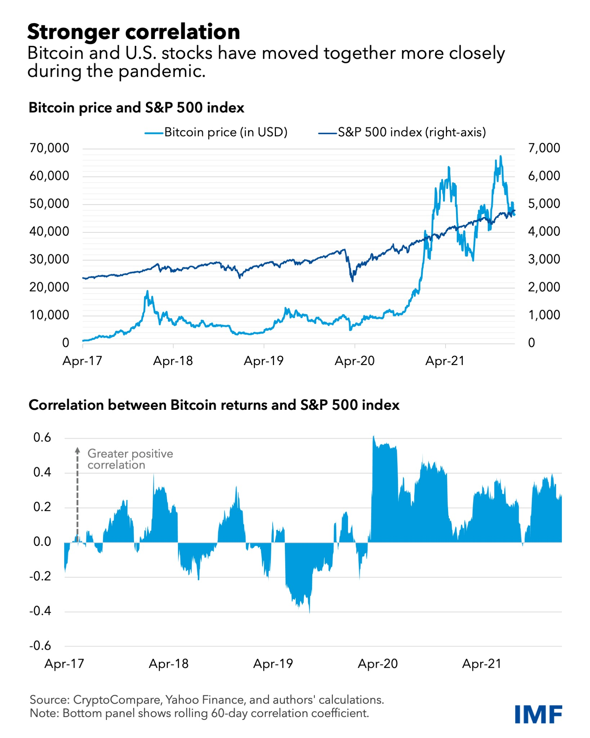
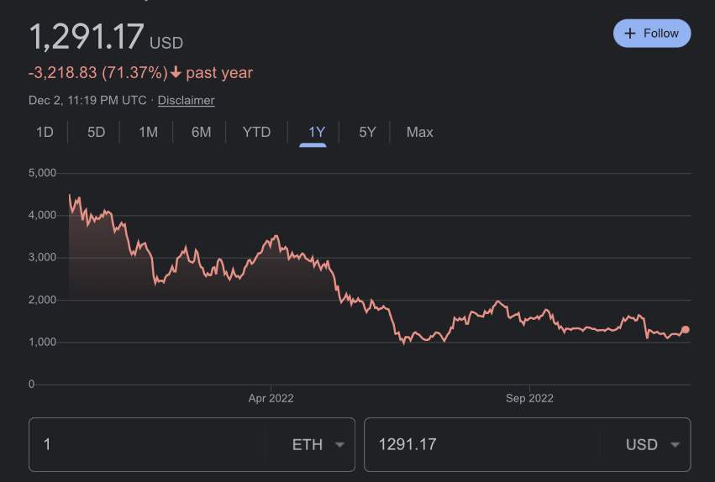
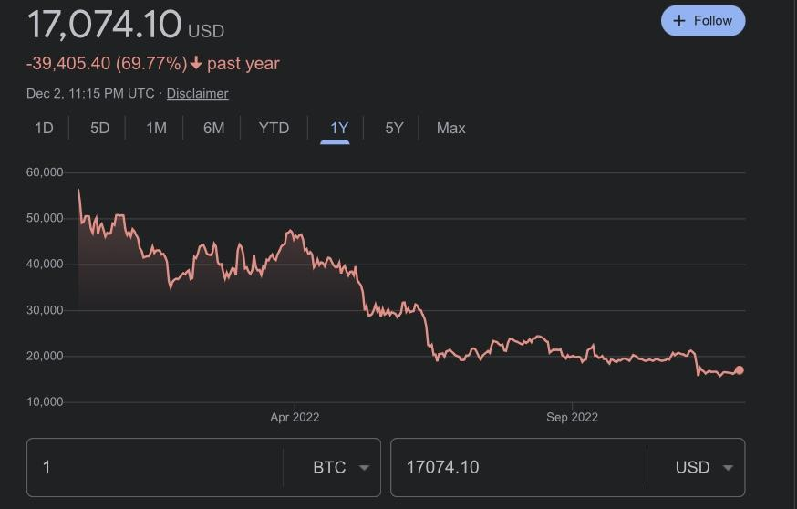
Graphs

Slide 8
Our claim
We don’t suggest moving forward with either crypto-currency.

Slide 9

Dangers of going forward with crypto-currency
FTX is a digital currency exchange company
Three weeks ago the company lost billions of dollars in valuation.Leading to a filing of bankruptcy
The company was extremely popular with funding from popular sports athletes, and Fortune 500 companies.

Slide 10
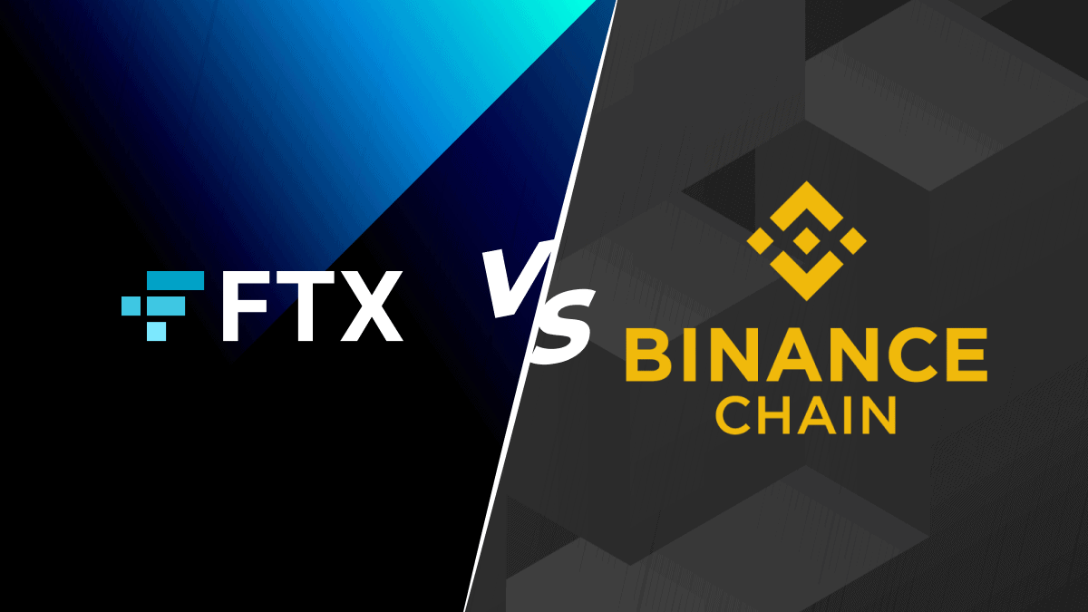
What happened to FTX?
FTX CEO Sam Bankman-Fried misuse of company funds in an attempt to become the most popular cryptocurrency platform in the world
Strategies include: aggressive marketing, acquisition of other smaller companies, and low trading fees.
The launch of FTX along with it’s huge success drove coins such as Bitcoin and Doge to All-Time Highs. Bitcoin reaching over $60,000 for just one coin.
Notes:
Talk about the superbowl commercial as final coffin in FTX next slide

Slide 11

The nail in the coffin for Crypto and FTX
FTX became the first company to ever advertise crypto during the 2021 Super Bowl
The reported cost of the 2 minute ad was around $6.5 million dollars
As the popularity of FTX rose, the hype around crypto slowly decayed.
Today, millions of customers are withdrawing crypto straining the future of crypto all together
Notes:
https://fortune.com/2022/02/14/crypto-companies-super-bowl-ads-coinbase-ftx-bitcoin-ether/

Slide 12
References
https://www.nerdwallet.com/article/investing/what-is-bitcoin
https://www.investopedia.com/terms/e/ethereum.asp
https://fortune.com/2022/02/14/crypto-companies-super-bowl-ads-coinbase-ftx-bitcoin-ether/
https://www.nbcnews.com/tech/crypto/sam-bankman-fried-crypto-ftx-collapse-explained-rcna57582
https://cointelegraph.com/ethereum-for-beginners/bitcoin-vs-ethereum-key-differences-between-btc-and-eth
https://fortune.com/2022/02/14/crypto-companies-super-bowl-ads-coinbase-ftx-bitcoin-ether/
https://time.com/nextadvisor/investing/cryptocurrency/bitcoin-and-ethereum-prices-usually-mirror-the-stock-market-is-that-changing/
https://time.com/nextadvisor/investing/cryptocurrency/ethereum-hits-new-all-time-high-price/

Slide 13
Any Questions?

